Slide 1
Clinical Track Summary
Graeme Meintjes
University of Cape Town
RAI, Amsterdam, 27 July 2018
Notes:
Better resolution image

Slide 2
No conflicts of interests to disclose

Slide 3
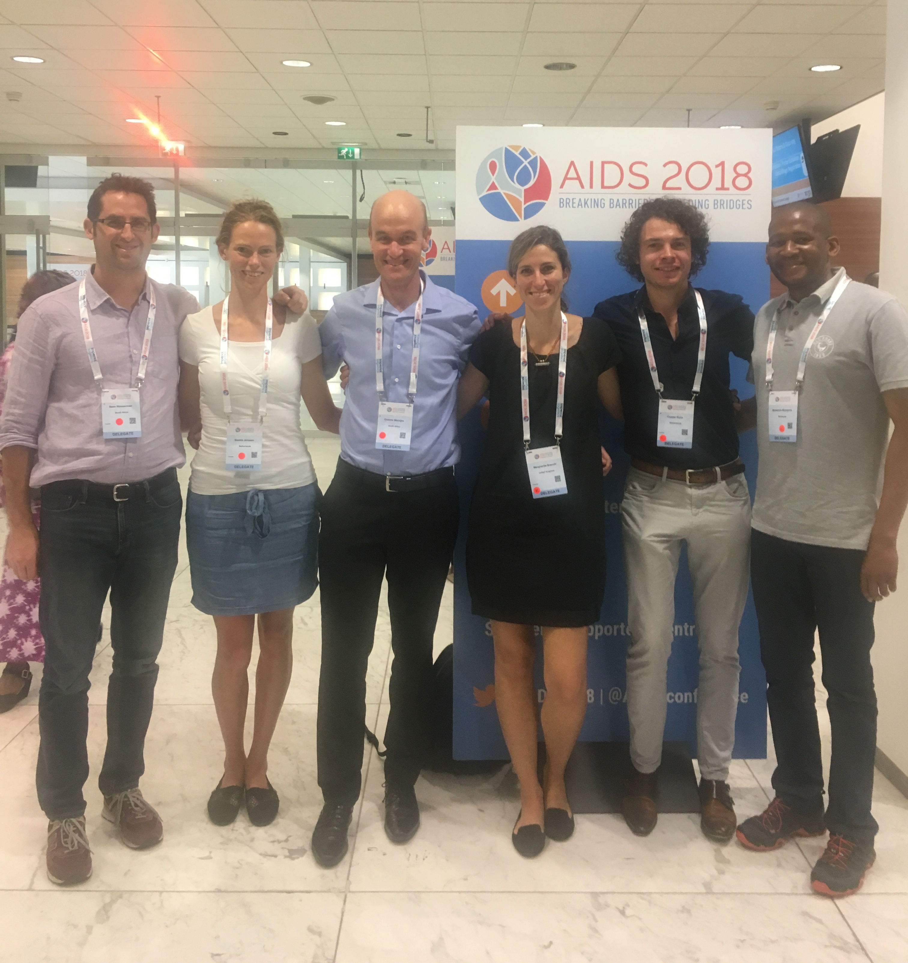
Track B Rapporteur Team
Margherita Bracchi
Chelsea and Westminster, UK
Saskia Janssen
Amsterdam UMC
Mosepele Mosepele
University of Botswana
Casper Rokx
Erasmus MC, Rotterdam, Netherlands
Sean Wasserman
University of Cape Town, South Africa

Slide 4
Clinical Track
Highlights
Dolutegravir in triple, dual and monotherapy
Dolutegravir in pregnancy
Dolutegravir with TB treatment
Paediatric ART formulation
Kaposi sarcoma treatment
Two community randomized interventions

Slide 5
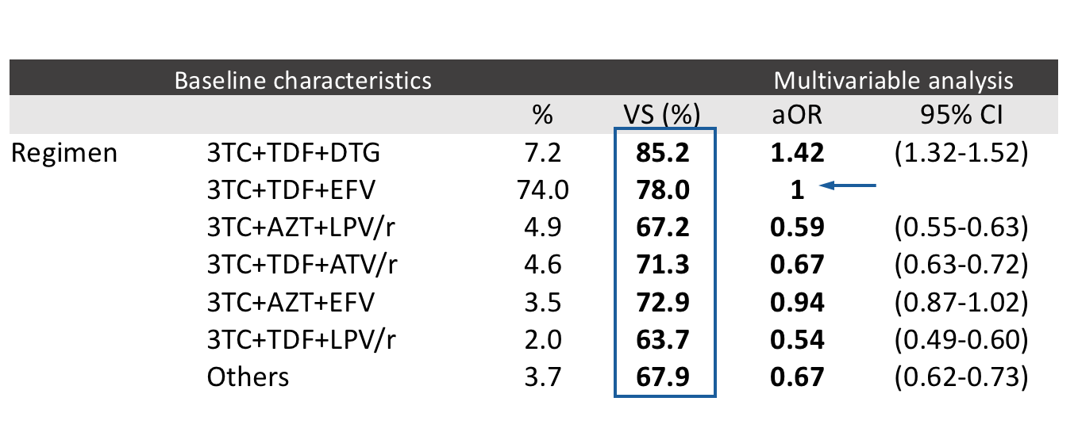
Dolutegravir in triple therapy Brazilian comparative effectiveness study of first-line ART
3TC+TDF+DTG introduced as first line in 2017
VS = Virologic suppression (< 50 copies/ml at 6 months)
42% higher odds and 7% absolute difference in virologic suppression vs efavirenz
Veloso Meireles et al, TUAB0101
Notes:
Used health systems data
103,000 patients analysed
Adjusted for age, sex, baseline CD4 and VL, adherence (using dispensing data)

Slide 6
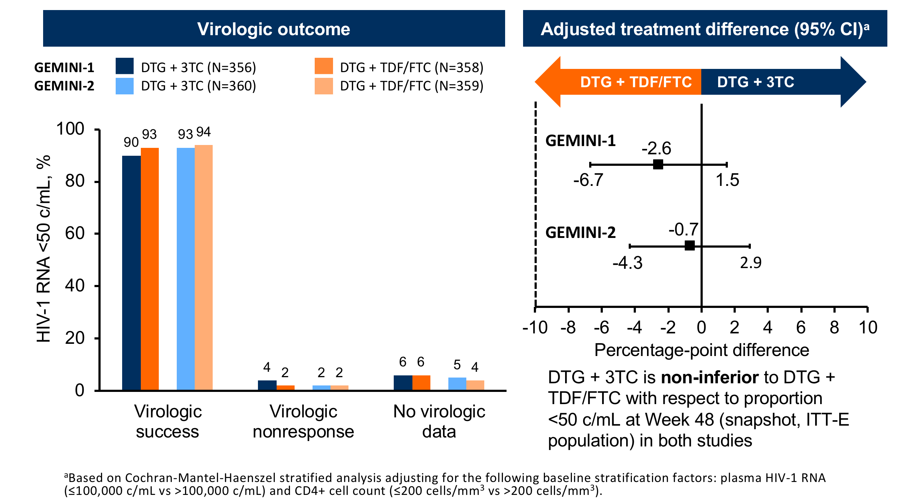
Dolutegravir in dual therapy Week 48 outcomes of GEMINI- 1 and 2 in treatment-naïve patients
Cahn et al, TUAB0106LB
Notes:
FDA snapshot
VL < 500,000

Slide 7
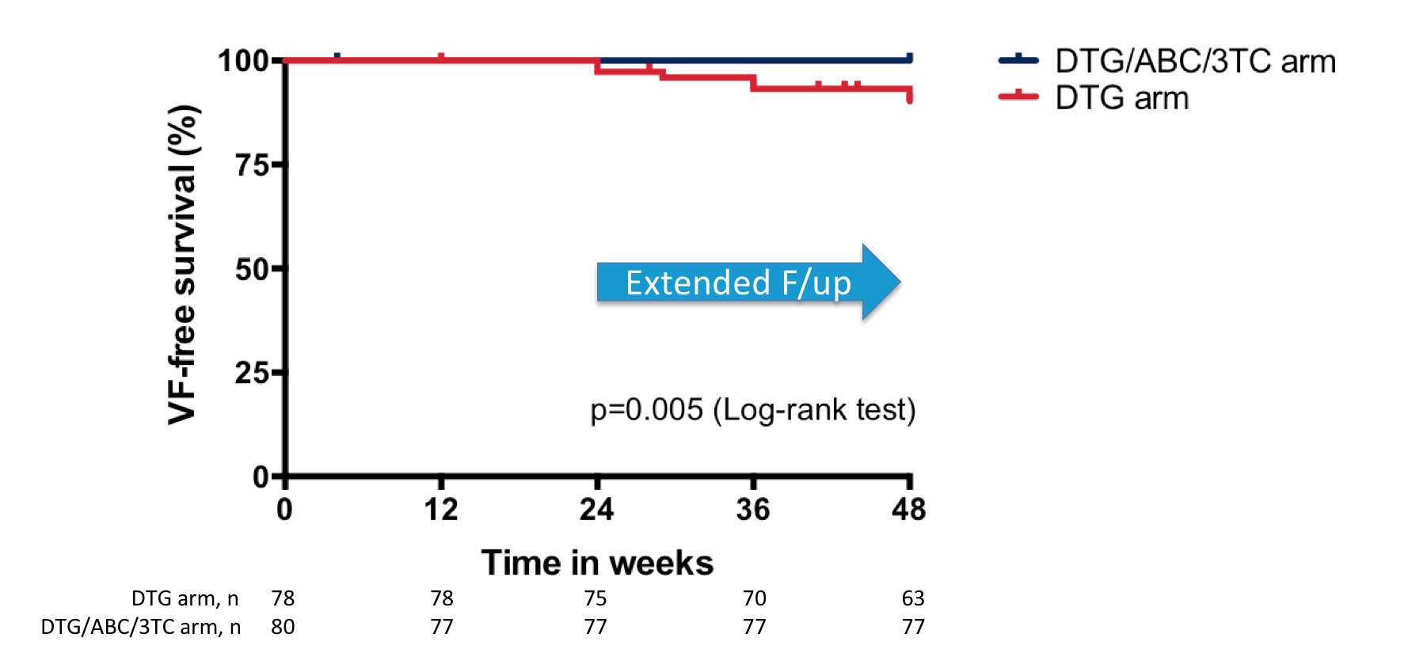
Switch to dolutegravir monotherapy MONCAY trial
HIV-RNA < 50 copies/mL > 12 months
No prior AIDS event
Nadir CD4 > 100
Randomised to:
Switch to DTG monotherapy (n=78)
Stay on ABC/3TC/DTG (n=80)
Dolutegravir maintenance monotherapy
cannot be recommended in clinical practice
Virologic failure in 7 patients
Emergent InSTI resistance in 2
Hocqueloux et al, TUAB0103

Slide 8
Dolutegravir started in late pregnancy DolPHIN-1 pilot trial
Greater proportion of mothers initiating ART late in pregnancy achieved
HIV-1 RNA <50 copies/mL with DTG- compared to EFV- based regimens
Khoo et al, THAB0307LB

Slide 9
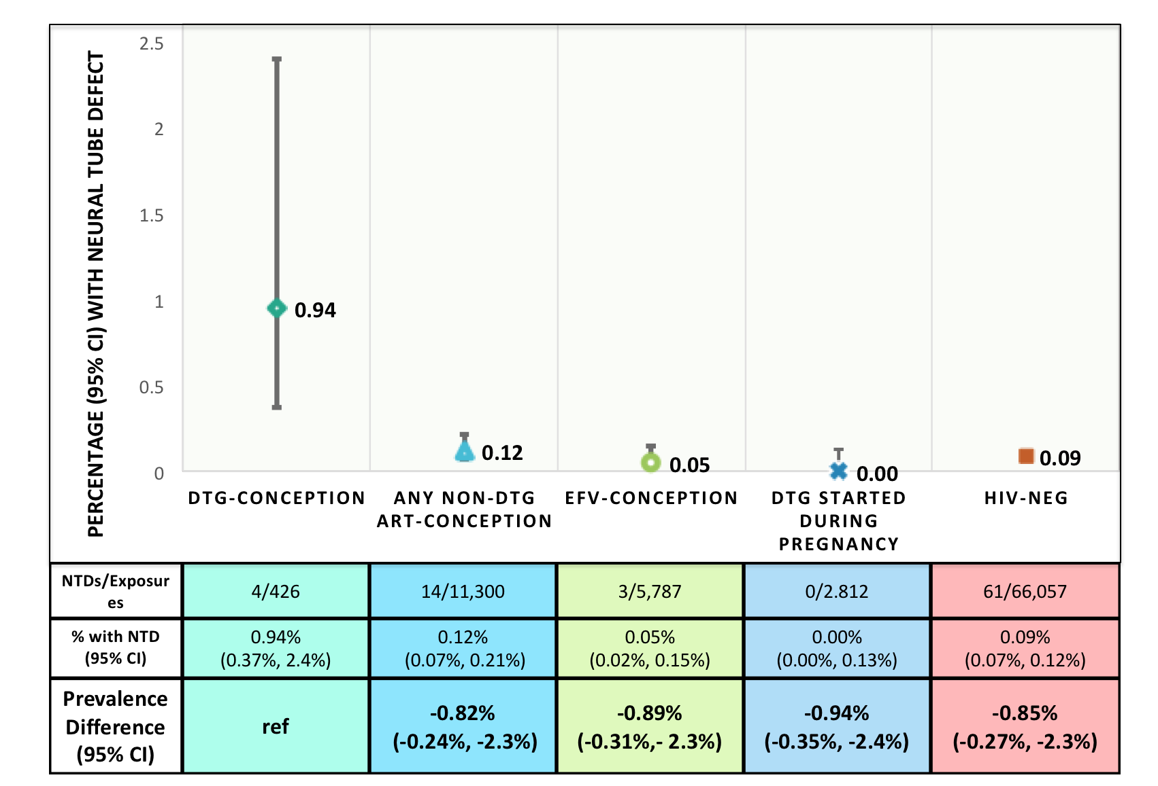
Dolutegravir exposure at conception Tsepamo study, Botswana
Dolutegravir at conception
Neural tube defects in
4/426 pregnancies (0.94%)
Updated data since 1 May:
4/596 (0.67%)
95%CI still does not overlap
with other groups
Zash, TUSY15

Slide 10
Dolutegravir with TB treatment INSPIRING trial
Rifampicin reduces dolutegravir levels
Advised to increase dose
50mg daily to 50mg twice daily
Results showed:
High virological efficacy
Few drug-related adverse events
No increase in TB-IRIS
PK comparable to dolutegravir 50mg daily without rifampicin
Dooley et al, TUAB0206
Notes:
Similar rates of virological non-response, not powered for formal statistical comparison

Slide 11
Lopinavir/ritonavir pellets in young children
LIVING study
Viral suppression stratified by prior ART
(% VL <400 copies/ml)
Open label single arm study in East Africa
Children 3 – 25 kg
Unable to swallow tablets
ART-naïve, requiring or continuing LPV/r
354 children with complete follow up data
Improved virologic suppression
Improved anthropometric measures
 | Baseline | Week 24 | Week 48
LPV/r | 61.6 | 78.8 | 80.1
Overall | 53.5 | 77.7 | 80.0
Wamalwa et al, WEAB0204

Slide 12
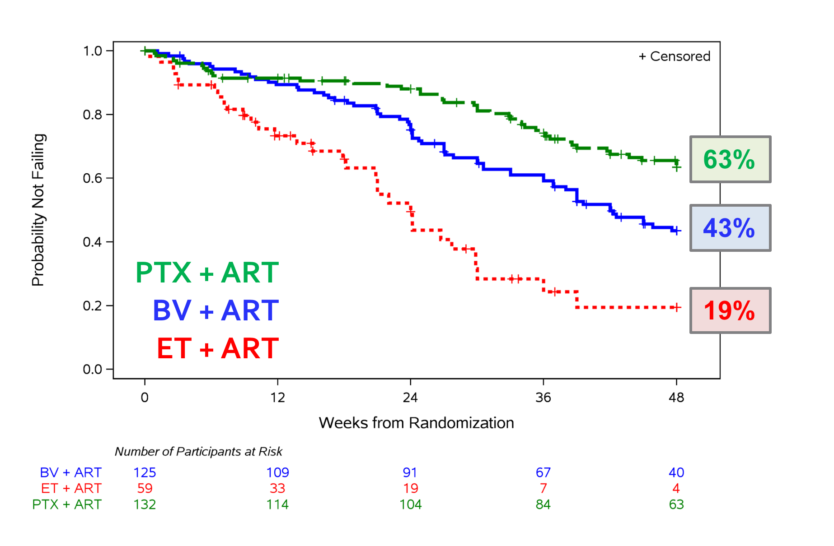
Treatment of advanced Kaposi sarcoma A5263/AMC-066 trial
Primary endpoint = Progression-free survival at 48 weeks
3 arm non-inferiority randomized trial
in resource limited setting
Paclitaxel + ART
Bleomycin/Vincristine + ART
Etoposide + ART (oral)
Stopped early by DSMB
Paclitaxel + ART was superior
without excess of adverse events
Paclitaxel not yet widely available
Krown et al, THAB0108LB
Notes:
PFS 44% better than etoposide
20% better than bleomycin/vincristine and 95% CI excludes zero
Establishes paclitaxel as SOC in RLS

Slide 13
Community cluster randomized trial Botswana Combination Prevention Project (BCPP)
15 intervention and 15 control communities, 2013-2018
Intervention:
Community mobilization + testing campaigns
Linkage to care support
Expanded ART:
CD4 351-500
or CD4 >500 + HIV RNA≥10,000
Strengthened male circumcision services
Universal ART in June 2016
Annualized HIV incidence (%)
30%
reduction
0.92%
New infections:
57/4257 in the intervention arm
90/4290 in standard of care arm
Makhema et al, WEAX0105LB

Slide 14
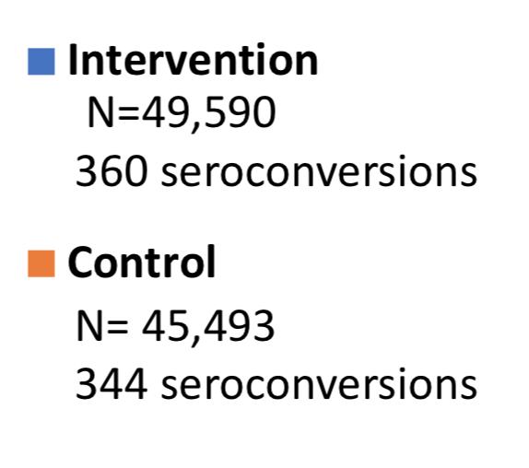
Community cluster randomized trial SEARCH trial in Uganda and Kenya
3-year cumulative
HIV incidence
16 intervention and 16 control rural communities, 2013-2017
Intervention:
Patient-centered, multi-disease package of interventions including annual testing campaigns and universal rapid ART initiation
Significant benefits observed
↑ ART coverage
↑ Virologic suppression (15%)
↓ HIV-associated mortality (21%)
↓ HIV-TB incidence (59%)
No difference in incidence
Havlir et al, WEAX0106LB
Notes:
Description

Slide 15
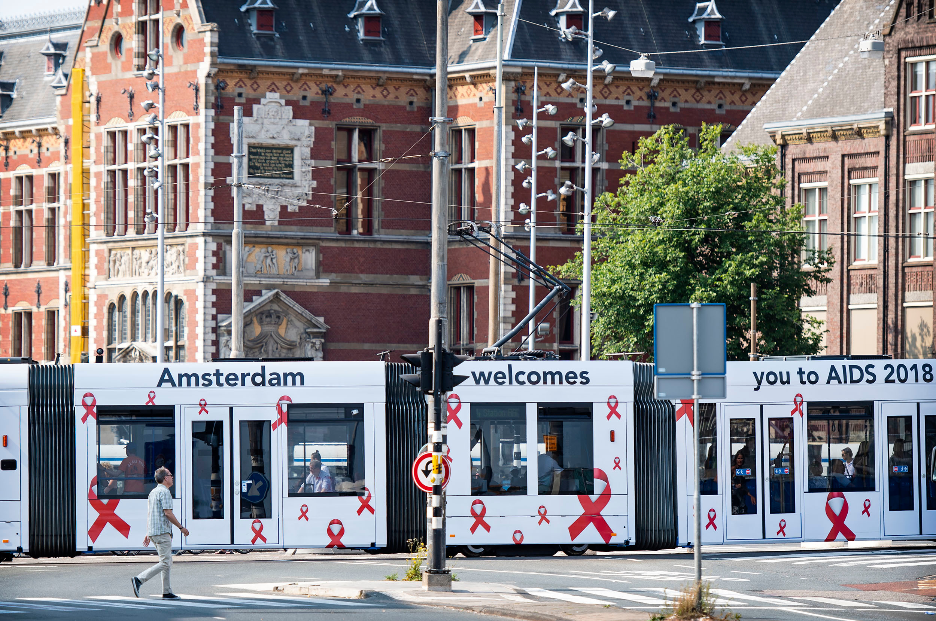
THANK YOU
Amsterdam, IAS, and all in our HIV community
working towards beating this epidemic

